Slide 1
Walk on Subdomains A Sharp Restart Point Evaluation using Machine Learning
By Christoph Hagenauer – April 29th 2025
In loving memory of Oma
Notes:
Good morning everyone,
And welcome to my presentation on Walk on Subdomains, a sharp restart point evaluation using machine learning

Slide 2
Topics
Introduction
Background
Methodology
Machine Learning
Conclusion
Lessons learned
Notes:
Today, I am going to give you a brief introduction on the topic and the goal of this research
This will be followed by the background on the algorithm I used for this research
Afterwards I will be talking about how I gathered results and what was important, then I am going into machine learning
And finally I will give my conclusion and Lessons learned, which is meant for you, my peers, to learn from

Slide 3
Introduction
Algorithm estimates electrostic energy of a biomolecule in a solution
It uses two Monte Carlo Algorithms
Walk on Spheres – WoS
Estimates outside portion of linear Poisson-Boltzmann equation
Walk on Subdomains – WoSD
Estimates internal portion of linear Poisson-Boltzmann equation
Notes:
For this research I am using an algorithm which calculates electrostaic energy of a biomolecule in a solution
To do this it uses Monte Carlo Algorithms – these algorithms rely on randomness, which we will see on the following slides
The one algorithm is Walk on Spheres which in this case estimates the external portion of the linear Poisson-Boltzmann equation
The other one, which is an extentsion on Walk on Spheres is Walk on subdomians, which estimates the internal portion of the linear poission-boltzmann equation

Slide 4
Introduction
Monte Carlo estimator which combines Walk on Spheres (WoS) and Walk on Subdomains (WoSD)
WoSD one of many methods to calculate electrostatic free energy of a biomolecule in a solution

Slide 5
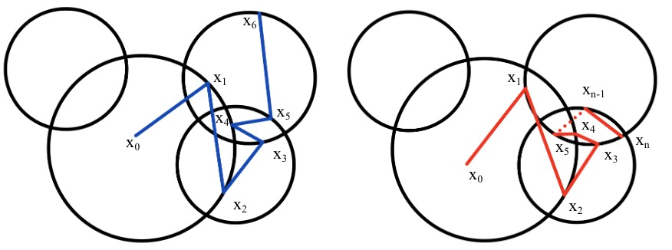
Introduction – Description of Challenge
Notes:
Describe problem of getting stuck – stay at high level
Before we get into this too deep, I want to provide a brief overview of the challenge at hand
On the right we see the walk finishing after 6 steps - and the one on the left getting stuck
This is what this research is going to be on – determining the best number of steps after which the algorithm should restart and try a different path.

Slide 6
Introduction Focus of this work
Focus on WoSD Sharp Restart Point
Gather lots of results for machine learning
Finding a good restart point, defined by:
It gives the same underlying estimate
It provides some speedup compared to the non-restart version
It stabilizes overall runtime
This is very important for the parallel version of the code
Notes:
Summarize the goals of this work

Slide 7
Background Walk on Spheres
Used to solve Dirichlet problems for variety of elliptic and parabolic partial differential equations
WoS first introduced by Müller
Solved the N-dimensional Dirichlet problem for the Laplace equation
Introduced Monte Carlo methods using stochastic models which are Markov processes
These techniques are proven to converge with probability 1
Yield statistical estimate for N-dimensional Dirichlet problem

Slide 8
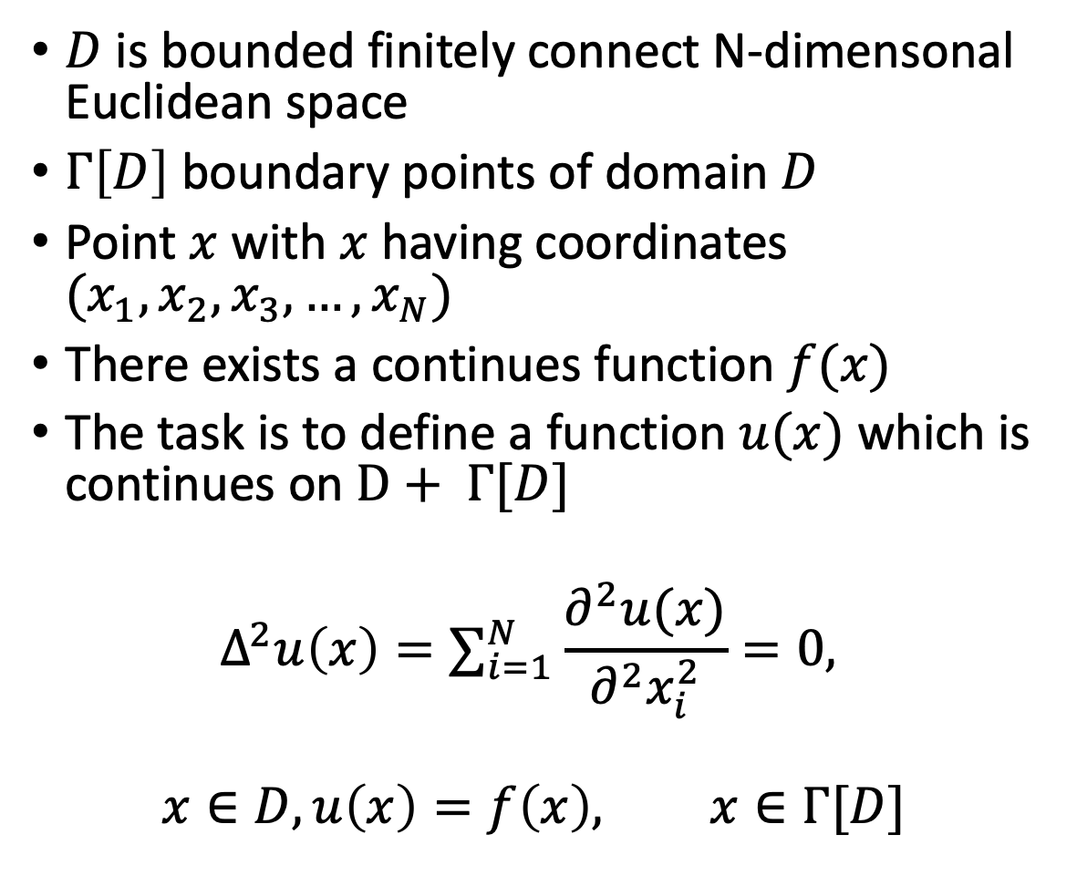
Background WoS Müller
$D$ is bounded finitely connect N-dimensonal Euclidean space
$Γ\left[D\right]$ boundary points of domain $D$
Point $x$ with $x$ having coordinates $(x_{1}, x_{2}, x_{3}, …, x_{N})$
There exists a continues function $f(x)$
The task is to define a function $u(x)$ which is continues on $D+ Γ[D]$
$$Δ^{2}u\left(x\right)=∑_{i=1}^{N}\frac{∂^{2}u(x)}{∂^{2}x_{i}^{2}}=0,$$
$$x∈D, u\left(x\right)=f\left(x\right), x∈Γ[D]$$
Notes:
Müller first one to work on this back in 1956

Slide 9
Background WoS Müller
Proved that first-passage probabilities of Brownian motion can be used to estimate the N-dimensional Dirichlet problem
Proves Spherical process can be used to simulate Brownian motion – which we know as WoS
Brownian motion is defined as follows:
Probability space (Ω, ϵ, Pr), with Ω = {ω} is a set of elements ω, ϵ = {E}, which is a Borel field of subsets E of Ω. Pr(E) is a probability measure defined on ϵ that is countably additive and satisfies the normalization condition Pr(Ω) = 1.
Defines X(t, ω) as the well-known N-dimensional Brownian motion process starting from x, with X(t, ω) = {(x⁽¹⁾(t, ω), x⁽²⁾(t, ω), x⁽³⁾(t, ω), . . . , x^{(N )}(t, ω)) | 0 ≤ t < ∞, ω ∈ Ω}

Slide 10
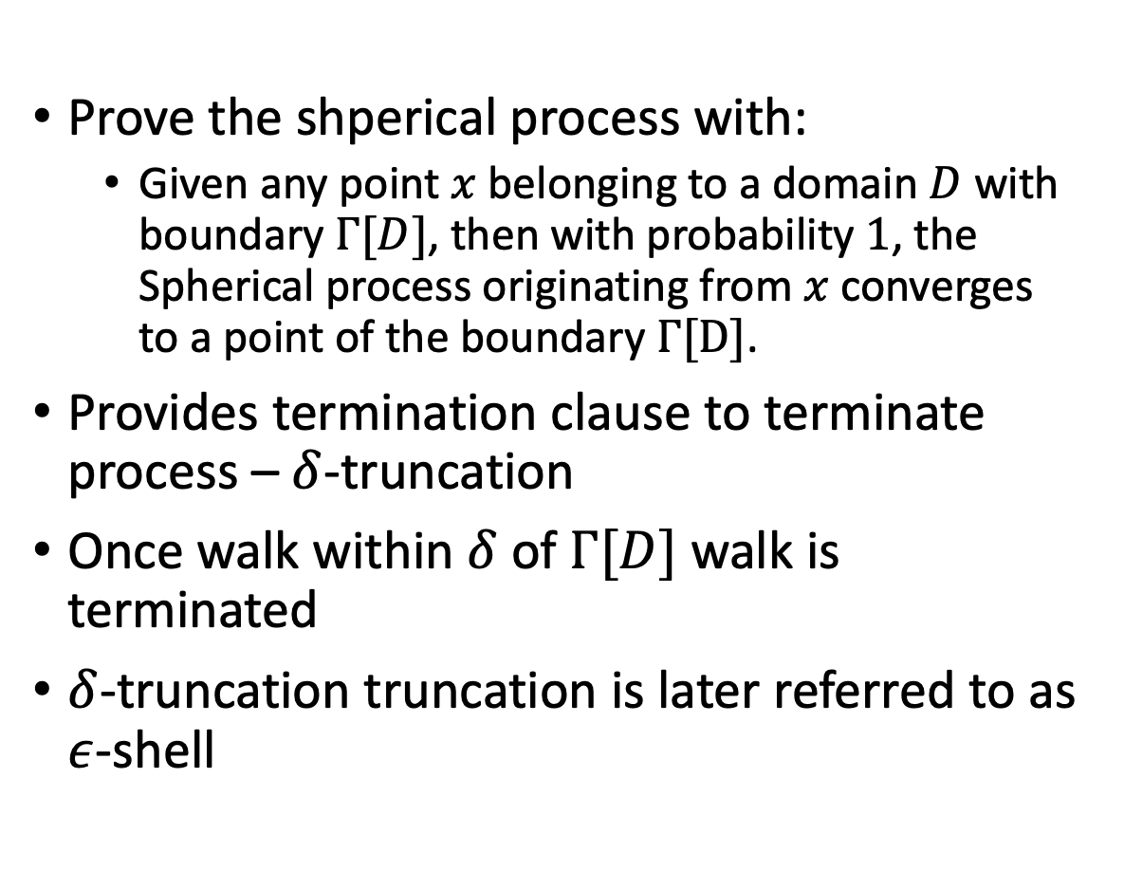
Background WoS Müller
Prove the shperical process with:
Given any point $x$ belonging to a domain $D$ with boundary $Γ[D]$, then with probability $1$, the Spherical process originating from $x$ converges to a point of the boundary $Γ[D]$.
Provides termination clause to terminate process – $δ$-truncation
Once walk within $δ$ of $Γ[D]$ walk is terminated
$δ$-truncation truncation is later referred to as $ε$-shell

Slide 11
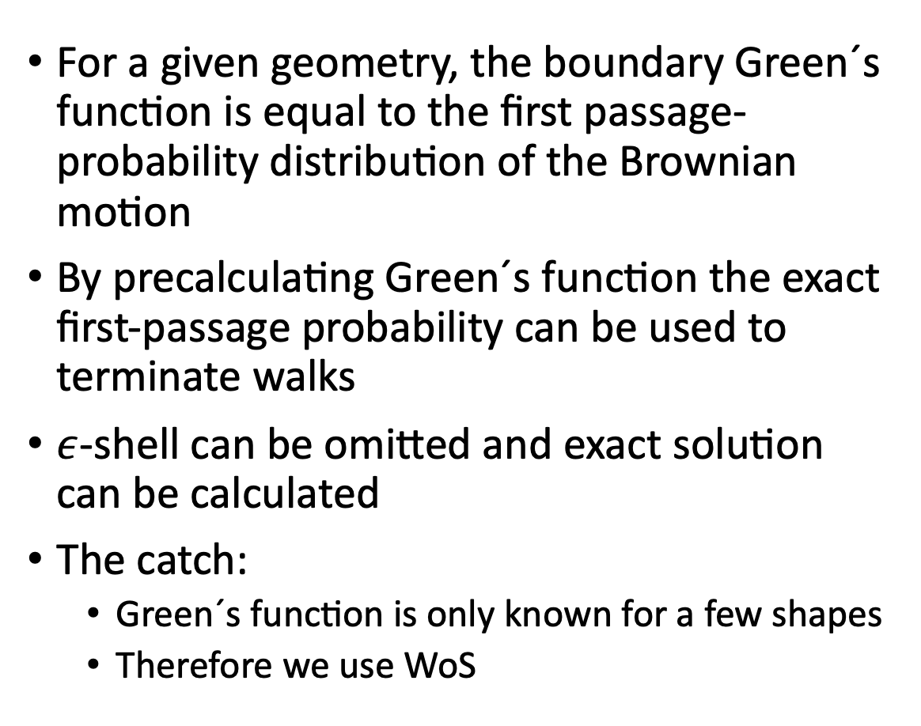
Background Alternative to WoS – Green´s function
For a given geometry, the boundary Green´s function is equal to the first passage-probability distribution of the Brownian motion
By precalculating Green´s function the exact first-passage probability can be used to terminate walks
$ε$-shell can be omitted and exact solution can be calculated
The catch:
Green´s function is only known for a few shapes
Therefore we use WoS

Slide 12
Background Other Applications of WoS
Haji-Sheikh and Sparrow expand on WoS to provide solution of heat conduction problems
Booth used weighted WoS to solve homogeneous elliptic partial differential equations with constant coefficients
Hwang, Mascagni, and Won use WoS to compute the capacitance of the unit cube

Slide 13
Background WoS connection WoSD
Both equivalent to simulating first-passage location of Brownian motion from a domain
WoSD essentially builds on WoS and has the advantage of being able to simulate more complex shapes
WoSD is faster than WoS

Slide 14
Background Walk on Subdomains
A given point is within a subdomain then it is possible to find an exit point of said subdomain
If in another subdomain, repeat process until at exterior
Fastest and most precise method would be Green´s function with the limitations as explained earlier

Slide 15
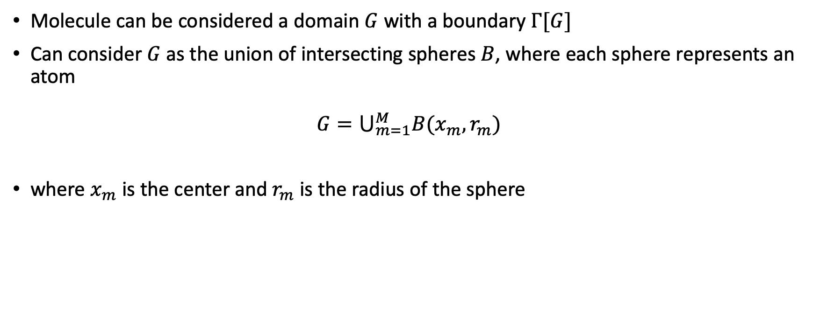
The Algorithm - Biomolecule
Molecule can be considered a domain $G$ with a boundary $Γ[G]$
Can consider $G$ as the union of intersecting spheres $B$, where each sphere represents an atom
$$G=⋃_{m=1}^{M}B(x_{m}, r_{m})$$
where $x_{m}$ is the center and $r_{m}$ is the radius of the sphere

Slide 16
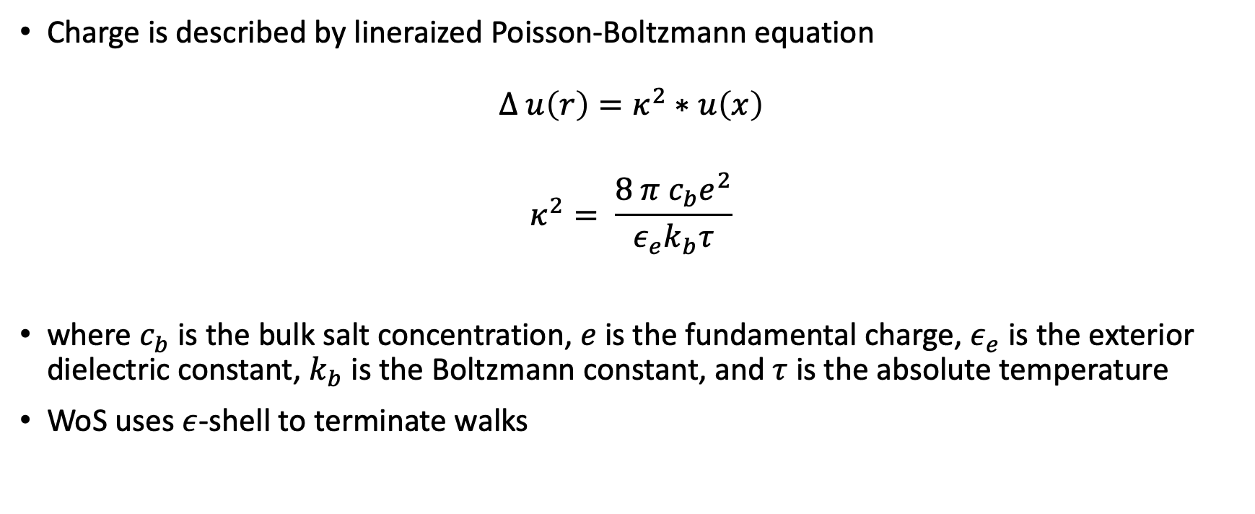
The Algorithm - WoS
Charge is described by lineraized Poisson-Boltzmann equation
$$Δ u\left(r\right)=κ^{2}∗u\left(x\right)$$
$$κ^{2}= \frac{8 π c_{b}e^{2}}{ε_{e}k_{b}τ}$$
where $c_{b}$ is the bulk salt concentration, $e$ is the fundamental charge, $ε_{e}$ is the exterior dielectric constant, $k_{b}$ is the Boltzmann constant, and $τ$ is the absolute temperature
WoS uses $ε$-shell to terminate walks
Notes:
This introduces an error, however this error is smaller than statistical sampling error
Investigated by Mascagni and Hwang
Error is linear
When precision is required use Green´s function

Slide 17
The Algorithm – WoS Steps
Notes:
When outside the molecule, walk follows the exterior WOS algorithm
1. A walker is at some point xk
2. Find the nearest point of intersection with the molecule boundary and calculate the distance
dk between the walker and that point
3. Generate a sphere with radius equal to dk
4. Sample to a random point xk+1 on that sphere
5. If the new location is on the boundary, this portion of the walk is over, otherwise return to step 1
In order to speed up convergence time, any walker within a small distance ϵ of the boundary is considered a “hit”, forming a region often called the ϵ-shell.

Slide 18
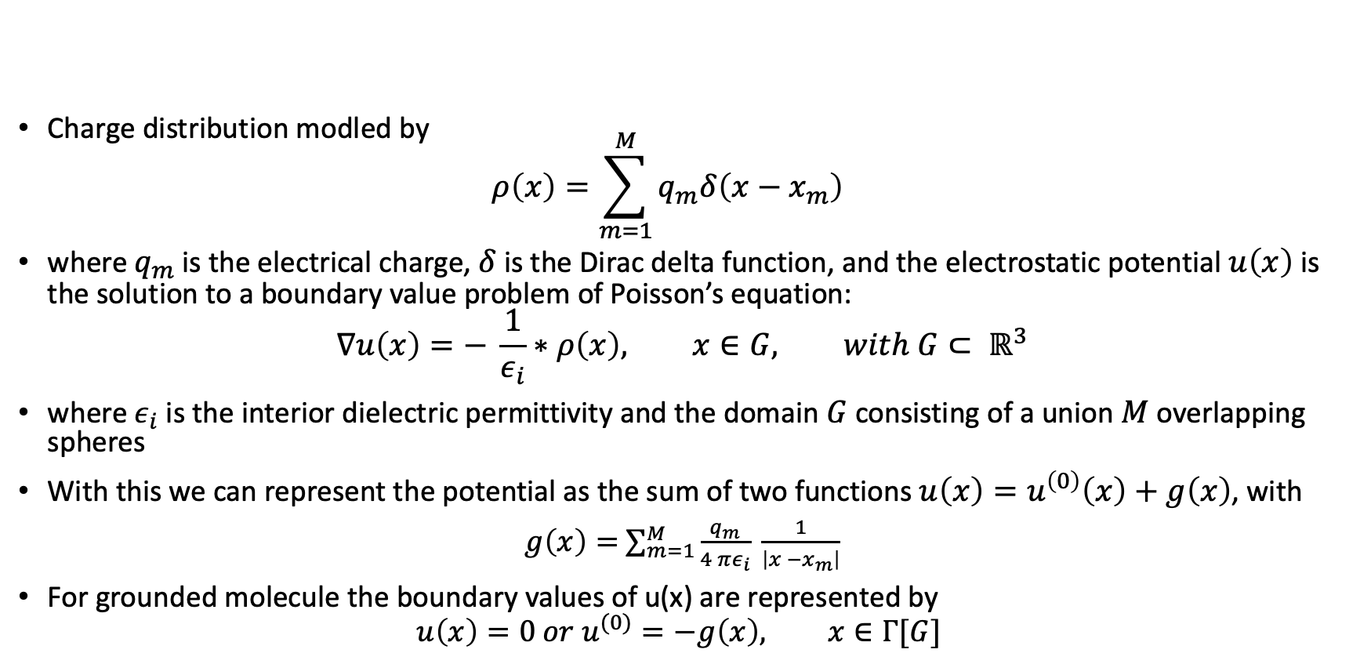
The Algorithm - WoSD
Charge distribution modled by $ρ\left(x\right)=\sum_{m=1}^{M}{q_{m}δ\left(x−x_{m}\right)}$
where $q_{m}$ is the electrical charge, $δ$ is the Dirac delta function, and the electrostatic potential $u\left(x\right)$ is the solution to a boundary value problem of Poisson’s equation:
$$∇u\left(x\right)=− \frac{1}{ε_{i}}∗ρ\left(x\right), x∈G, with G⊂ ℝ^{3}$$
where $ε_{i}$ is the interior dielectric permittivity and the domain $G$ consisting of a union $M$ overlapping spheres
With this we can represent the potential as the sum of two functions $u\left(x\right)=u^{\left(0\right)}\left(x\right)+g\left(x\right)$, with
$g\left(x\right)=$ $\sum_{m=1}^{M}{\frac{q_{m}}{4 πε_{i}} \frac{1}{\left|x −x_{m}\right|}}$
For grounded molecule the boundary values of u(x) are represented by
$$u\left(x\right)=0 or u^{(0)}=−g\left(x\right), x∈Γ[G]$$

Slide 19
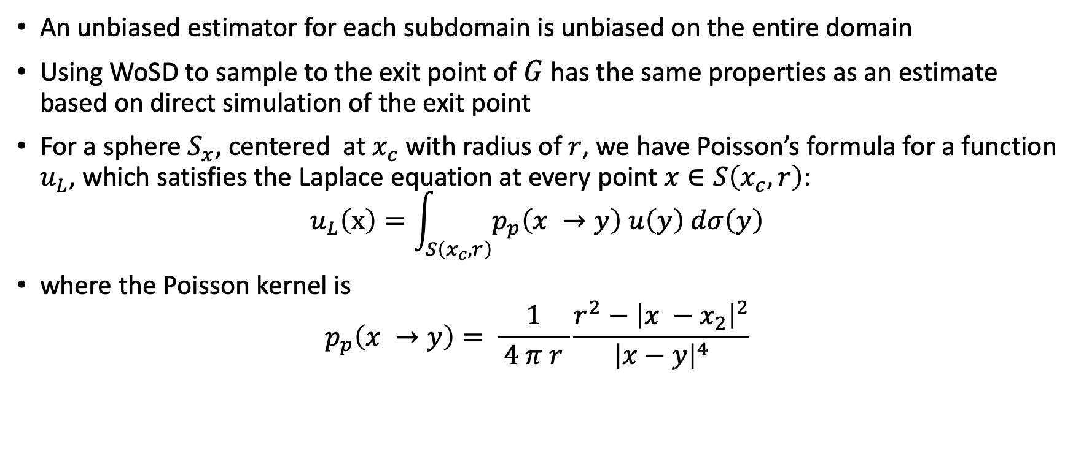
WoSD - Observations
An unbiased estimator for each subdomain is unbiased on the entire domain
Using WoSD to sample to the exit point of $G$ has the same properties as an estimate based on direct simulation of the exit point
For a sphere $S_{x}$, centered at $x_{c}$ with radius of $r$, we have Poisson’s formula for a function $u_{L}$, which satisfies the Laplace equation at every point $x∈S\left(x_{c}, r\right)$:
$$u_{L}\left(x\right)=\int_{S\left(x_{c}, r\right)}{p_{p}\left(x →y\right) u\left(y\right) dσ\left(y\right)}$$
where the Poisson kernel is
$$p_{p}\left(x →y\right)= \frac{1}{ 4 π r }\frac{r^{2}−{\left|x −x_{2}\right|}^{2}}{{\left|x−y\right|}^{4}}$$

Slide 20
The Algorithm – Sharp Restart in WoSD
Some walks become entrapped in the geometry which leads the walker to oscillate between two atoms
Entrapment happens due to low connectivity at any given point in the molecule and the bias of the Poisson kernel to sample towards points near the current walker´s position
Sharp restart is essential to make parallel version of the code run more efficiently
Specific implementation is based on research regarding first passage under restart (FPUR)
Best runtime is achieved by implementing a sharp restart point after a non-random number of steps

Slide 21
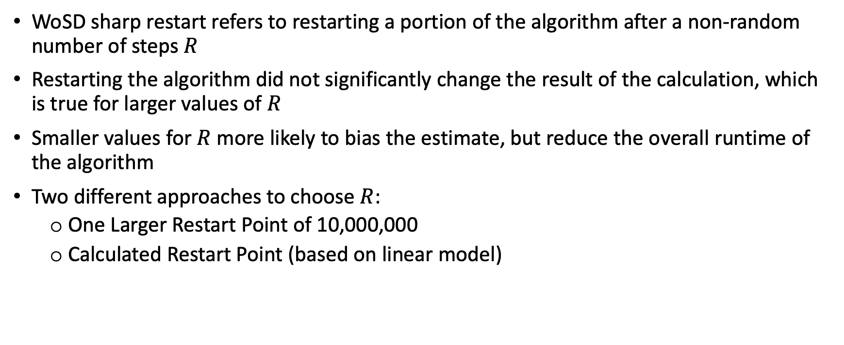
The Algorithm – Sharp Restart in WoSD
WoSD sharp restart refers to restarting a portion of the algorithm after a non-random number of steps $R$
Restarting the algorithm did not significantly change the result of the calculation, which is true for larger values of $R$
Smaller values for $R$ more likely to bias the estimate, but reduce the overall runtime of the algorithm
Two different approaches to choose $R$:
One Larger Restart Point of 10,000,000
Calculated Restart Point (based on linear model)
Notes:
Thrasher concludes to use a large restart point R of 10,000,000, since it performed better in many cases than a calculated restart point. Furthermore, he found that individual interior walk times are more stable after adding a sharp restart point

Slide 22
The Algorithm – WoSD steps
Notes:
Choose a point xm = x(0)m at the center of sphere S(xm, rm).
Generate a series of points {x(0) m , x(1) m , x(2) m , ..., x(Nm) m }.
At any step i in the sequence, we have a point x(i) m inside a sphere S(xj , rj ) for some index j and choose x(i+1) m randomly on the surface of the sphere S(xj , rj ).
If x(i) m is at the center of the sphere, then x(i+1) m is chosen according to the isotropic distribution.
If x(i) m is not at the center of the sphere, then x(i+1) m is chosen according to the Poisson kernel density on the surface of the atom.
Following this procedure x(i) m is either on Γ[G], or inside at least one other sphere S(xk, rk), where k̸ = m̸ = j.
If x(i) m is on Γ[G], the algorithm is complete. Otherwise, Steps 5 should be repeated until x(i) m is on Γ[G].

Slide 23
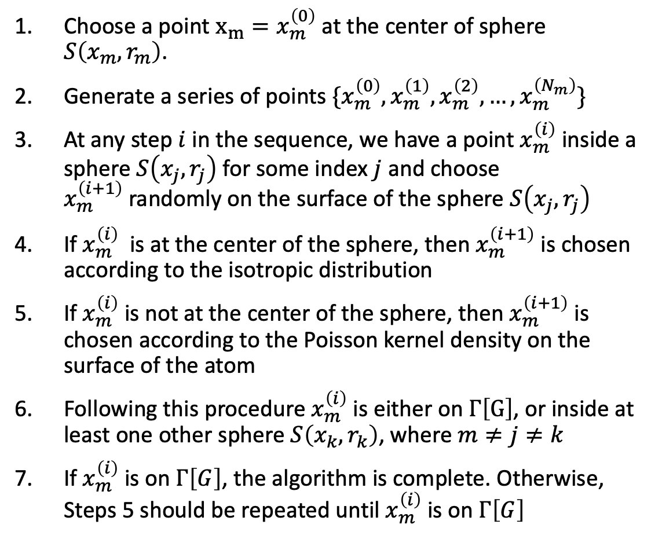
The algorithm – WoSD Steps
Choose a point $x_{m}=x_{m}^{\left(0\right)}$ at the center of sphere $S\left(x_{m}, r_{m}\right)$.
Generate a series of points $\{x_{m}^{\left(0\right)},x_{m}^{\left(1\right)},x_{m}^{\left(2\right)}, …,x_{m}^{\left(N_{m}\right)}\}$
At any step $i$ in the sequence, we have a point $x_{m}^{\left(i\right)}$ inside a sphere $S\left(x_{j}, r_{j}\right)$ for some index $j$ and choose $x_{m}^{\left(i+1\right)}$randomly on the surface of the sphere $S\left(x_{j}, r_{j}\right)$
If $x_{m}^{\left(i\right)}$ is at the center of the sphere, then $x_{m}^{\left(i+1\right)}$ is chosen according to the isotropic distribution
If $x_{m}^{\left(i\right)}$ is not at the center of the sphere, then $x_{m}^{\left(i+1\right)}$is chosen according to the Poisson kernel density on the surface of the atom
Following this procedure $x_{m}^{\left(i\right)}$ is either on $Γ\left[G\right]$, or inside at least one other sphere $S\left(x_{k}, r_{k}\right)$, where $m≠j≠k$
If $x_{m}^{\left(i\right)}$ is on $Γ\left[G\right]$, the algorithm is complete. Otherwise, Steps 5 should be repeated until $x_{m}^{\left(i\right)}$ is on $Γ\left[G\right]$

Slide 24
Goal for this work
Predict a good restart point which is defined as follows:
It gives the same underlying estimate
It provides some speedup compared to the non-restart version
It stabilizes overall runtime
Proposing two-step process:
Predict if the result is valid
Predict the runtime

Slide 25

Methodology – Selecting Molecules
Started with 20 handpicked molecules
Paid attention to shape, size, and connectivity
Collected 578 molecules with rcsapi – Protein databank
Structure similarity search with threshold > 0.7
Linearized Poisson Boltzmann solver requires coordinates, charge, and radii for each atom of the molecule
Converted molecules using pdb2pqr – parameters were kept consistent with previous work done on this algorithm
Had 562 molecules to use after conversion

Slide 26
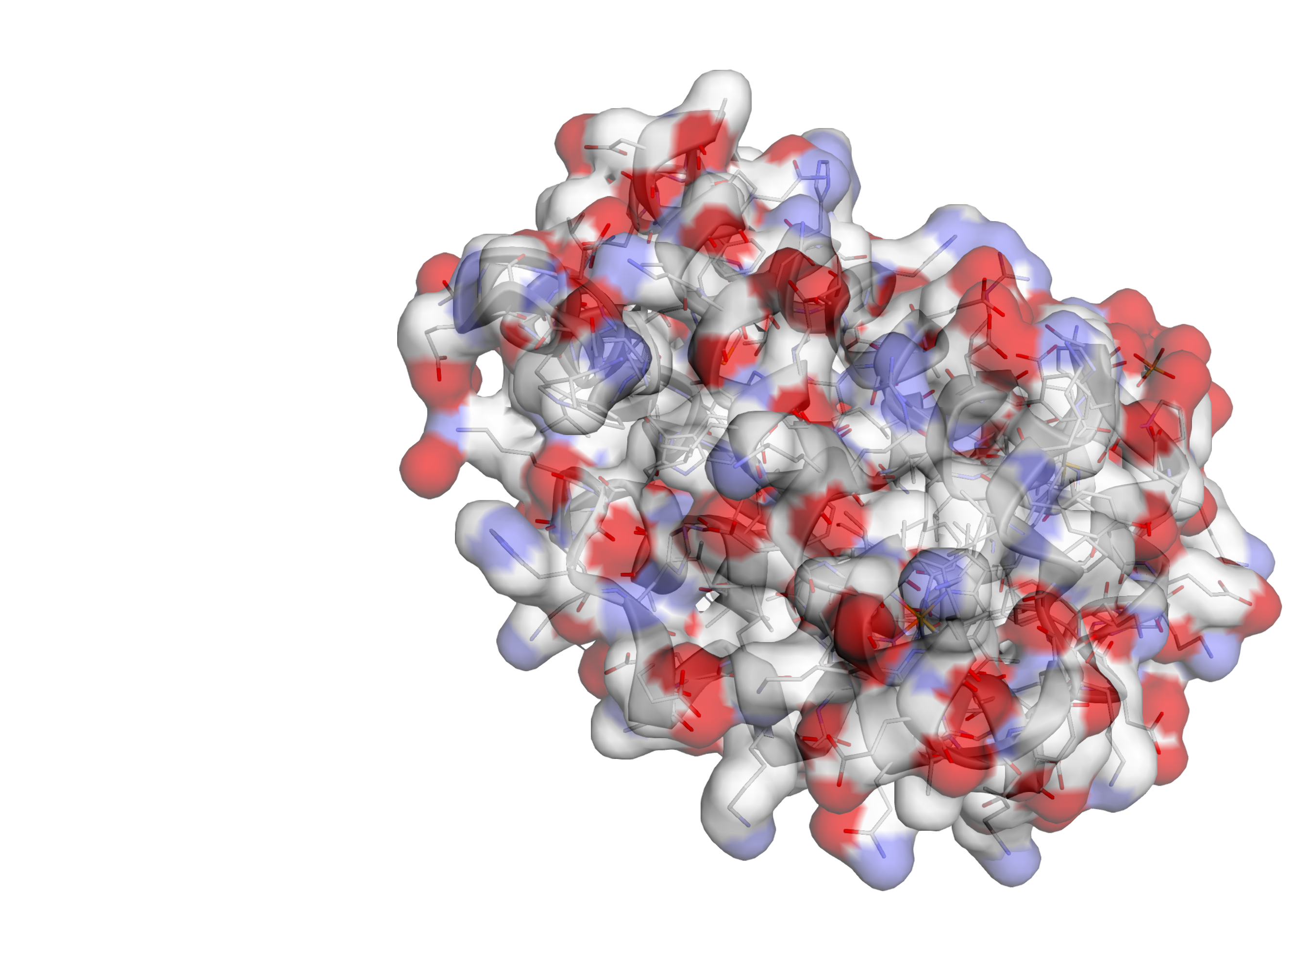
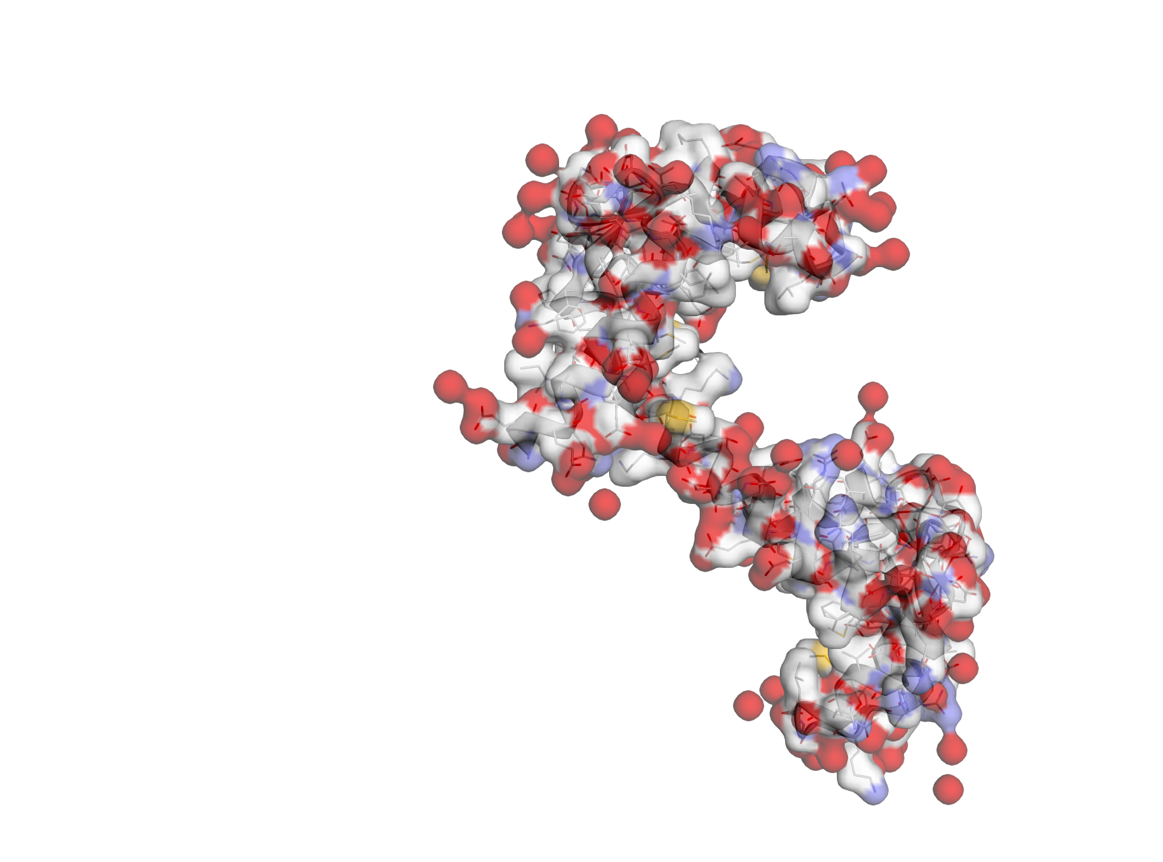
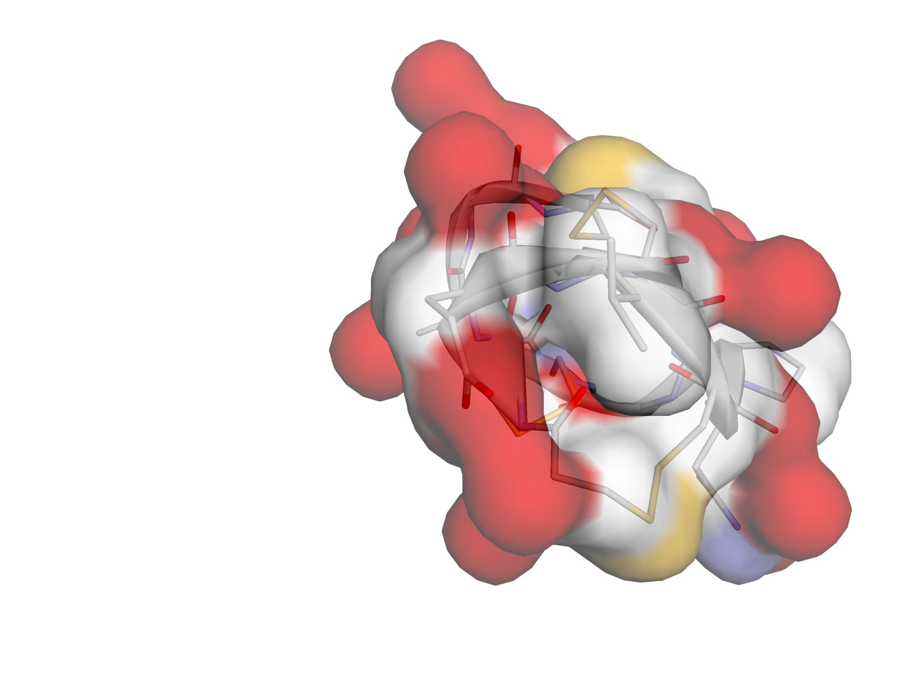
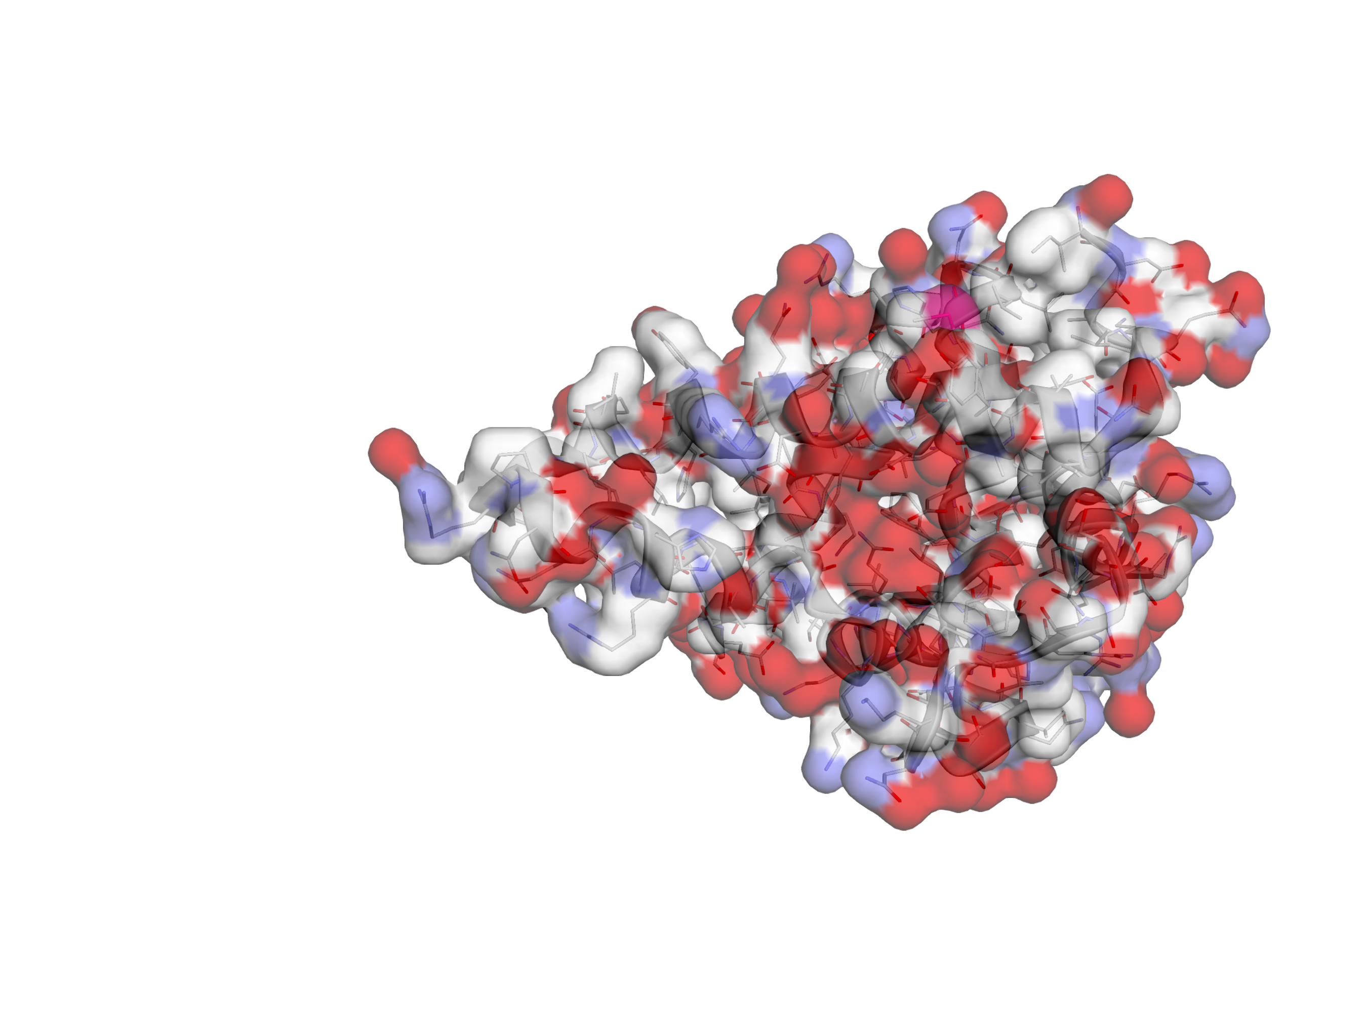
Methodology – some Sample Molecules

Slide 27
Methodology – Algorithm Results
Used USCB´s partition in USC´s high performance cluster
Each node equipt with Intel Xeon Platinum 8260 CPU @2.40 GHz and 192 GB of system memory
Uses Slurm to schedule jobs
Each job for this work was run using 1 Node and 1 Core
Algorithm was run with and without restart, as well as geometry calculation
Used 20 seeds and 20 restart points for each molecule
Algorithmic parameters were kept consistent with previous work

Slide 28
Methodology – Parallel Version
Originally planned to use parallel version
Discovered a bug during initial testing which caused inconsistencies within the estimates
Therefore, the serial version was used

Slide 29
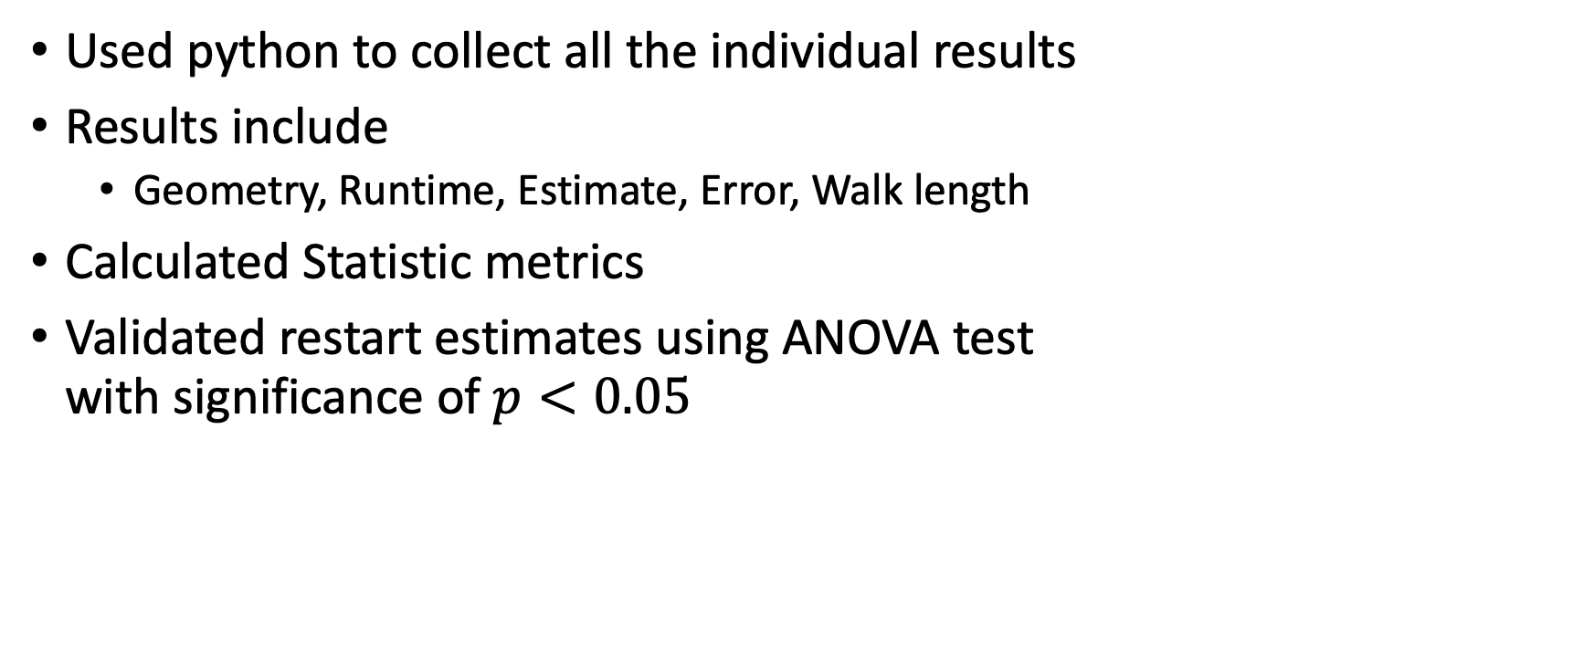
Machine Learning – Preparing the Data
Used python to collect all the individual results
Results include
Geometry, Runtime, Estimate, Error, Walk length
Calculated Statistic metrics
Validated restart estimates using ANOVA test with significance of $p<0.05$

Slide 30
Preprocessing – Linear Correlation
No linear correlation with Valid Result
No Linear correlation with Restart Point
Some linear correlation with Runtime
Decided to not perform any feature engineering such as leveraging the linear correlation

Slide 31
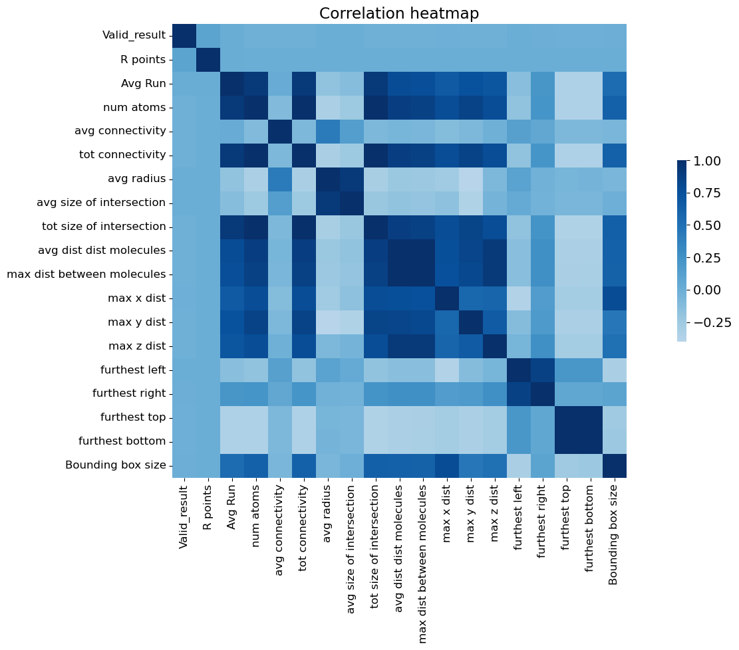
Machine Learning – Linear Correlation
Notes:
No linear correlation with Valid Result
No Linear correlation with Restart Point
Some linear correlation with Runtime
Decided to not perform any feature engineering such as leveraging the linear correlation

Slide 32
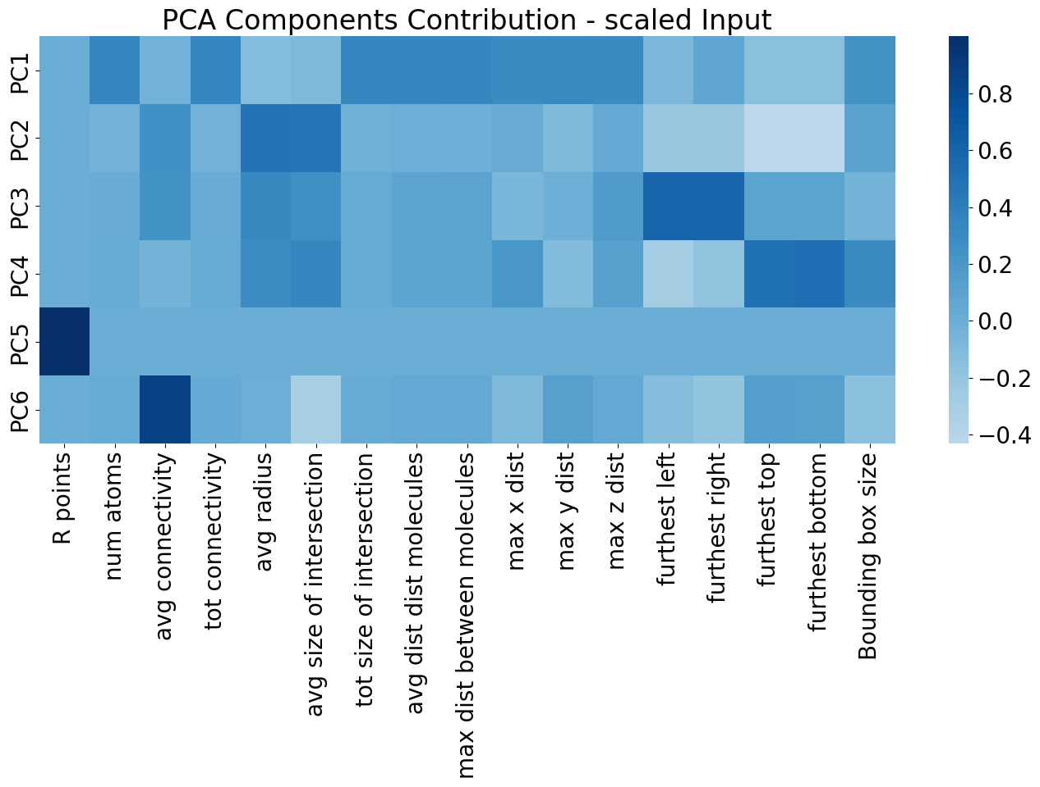
Machine Learning – PCA Analysis

Slide 33
Machine Learning – Scaling
Sclaed all continues data with Standard Scaler z = (x − u)/s
u is sample mean and s is sample standard deviation
Scaling is required as columns have vastly differing scales
After scaling columns have a mean of 0 and standard deviation of 1

Slide 34
Machine Learning – Balance in the target variable
R point | Total | Positive | Negative | Pos [%] | Neg [%]
20 | 562 | 0 | 562 | 0 | 100
25 | 560 | 12 | 548 | 2.14 | 97.86
50 | 562 | 522 | 40 | 92.88 | 7.12
75 | 562 | 533 | 29 | 94.84 | 5.16
100 | 562 | 536 | 26 | 95.37 | 4.63
125 | 562 | 546 | 16 | 97.15 | 2.85
150 | 562 | 551 | 11 | 98.04 | 1.96
175 | 562 | 545 | 17 | 96.98 | 3.02
200 | 562 | 555 | 7 | 98.75 | 1.25
225 | 562 | 554 | 8 | 98.58 | 1.42
250 | 562 | 552 | 10 | 98.22 | 1.78
500 | 562 | 556 | 6 | 98.93 | 1.07
1000 | 562 | 556 | 6 | 98.93 | 1.07
2500 | 562 | 554 | 8 | 98.58 | 1.42
5000 | 562 | 555 | 7 | 98.75 | 1.25
10000 | 562 | 556 | 6 | 98.93 | 1.07
100000 | 562 | 556 | 6 | 98.93 | 1.07
1000000 | 562 | 558 | 4 | 99.29 | 0.71
10000000 | 562 | 557 | 5 | 99.11 | 0.89
100000000 | 562 | 559 | 3 | 99.47 | 0.53
Total | 11238 | 9913 | 1325 | 88.21 | 11.79

Slide 35
Machine Learning – Predicting if the result is going to be valid
Data was split 60/40
Scaled the data
Focused on ensemble classifier
Gradient Boositing Classifier
Random Forest Classifier
Extra Trees Classifier
Bagging Classifier
Ada Boosting Classifier

Slide 36
Results for Classification
Model | Accuracy | Precision | Recall | F-1 Score | AUC
Gradient Boosting Classifier | 98% | 98% | 81% | 99% | 90%
Random Forest Classifier | 97% | 98% | 82% | 98% | 91%
Extra Trees Classifier | 91% | 94% | 52% | 95% | 74%
Bagging Classifier | 97% | 98% | 82% | 98% | 98%
Ada Boosting Classifier | 98% | 98% | 81% | 99% | 91%

Slide 37
Predicting Runtime
Focus on relationship between geometry and restart point with runtime
Look at
overall effect
molecule specific effect

Slide 38
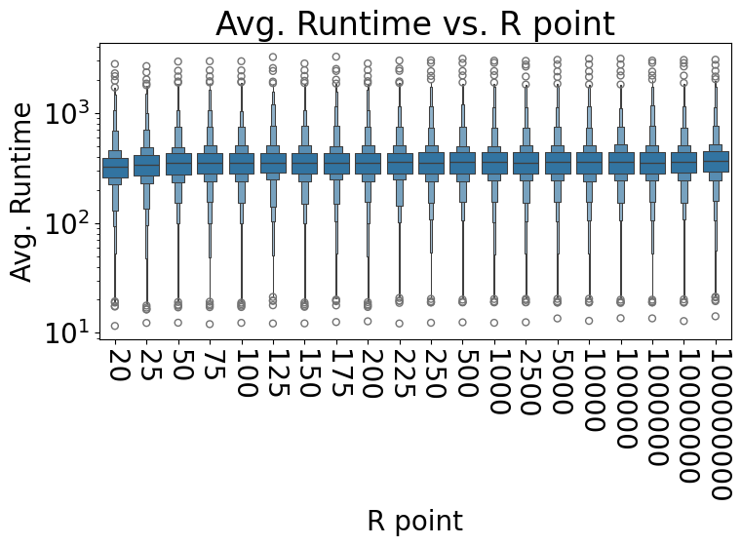

Slide 39
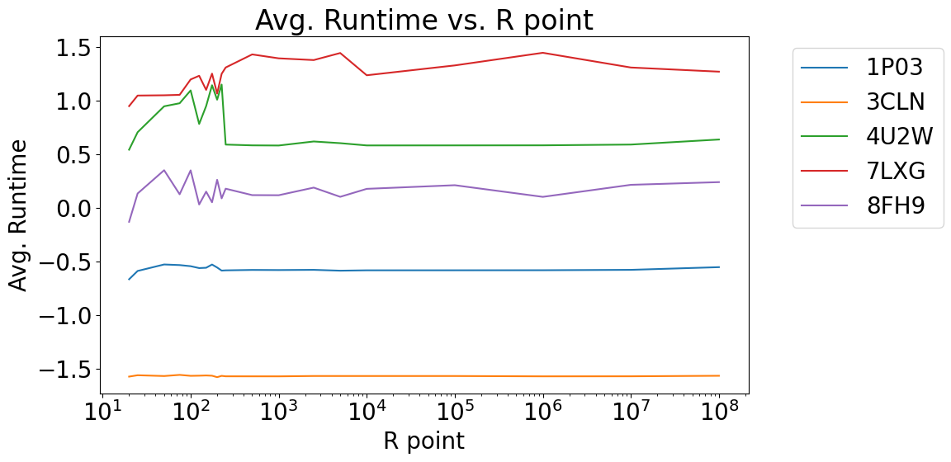

Slide 40
Predicting Runtime – Models
Regressor | MSE | RMSE | R2-score
Gradient Boosting Regressor | 0.01 | 0.11 | 0.99
Random Forest Regressor | 0.01 | 0.08 | 0.99
Extra Trees Regressor | 0.01 | 0.09 | 0.99

Slide 41
Conclusion
Showed feasibility of implementing machine learning to predict good restart point
Two-step process – based on geometry
Predicting the validity of the result
Predicting the runtime
Sharp restart stabilizes runtime
Have to look at individual results to see differences
True speed up comes from parallelization
Do not implement for serial version as the speedup is marginal

Slide 42
Lessons learned
Start early
Meet with your advisor regularly
Do NOT neglect your background and spend enough time on it
Plan enough time for writing as it is very different to your regular papers
Do NOT get discouraged by struggles, when you struggle you learn the most
Expect yourself to look at this work at some point and reconsider every step

Slide 43
References
[1] Hervé Abdi and Lynne J. Williams. “Principal component analysis”. In: WIREsComputational Statistics 2.4 (2010), pp. 433–459. doi: https://doi.org/10.1002/wics.101. eprint: https://wires.onlinelibrary.wiley.com/doi/pdf/10.1002/wics.101. url: https://wires.onlinelibrary.wiley.com/doi/abs/10.1002/wics.101.
[2] MdManjurulAhsanetal.“EffectofDataScalingMethodsonMachineLearning Algorithms and Model Performance”. In: Technologies 9.3 (2021). issn: 2227-7080. doi: 10.3390/technologies9030052. url: https://www.mdpi.com/2227-7080/9/3/52.
[3] Thomas E Booth. “Exact Monte Carlo solution of elliptic partial differential equations”. In: Journal of Computational Physics 39.2 (1981), pp. 396–404. issn: 0021-9991. doi: https : / / doi . org / 10 . 1016 / 0021 - 9991(81)90159- 5. url: https://www.sciencedirect.com/science/article/pii/0021999181901595.
[4] Lars Buitinck et al. “API design for machine learning software: experiences from the scikit-learn project”. In: ECML PKDD Workshop: Languages for Data Mining and Machine Learning. 2013, pp. 108–122.
[5] Rudolf N Cardinal and Michael RF Aitken. ANOVA for the behavioral sciences researcher. Psychology Press, 2013.
[6] Malcolm E Davis and J Andrew McCammon. “Electrostatics in biomolecular structure and dynamics”. In: Chemical Reviews 90.3 (1990), pp. 509–521.
[7] BS Elepov et al. “Solution of boundary value problems by the Monte Carlo method”. In: Science: Novosibirsk, Russia (1980).
[8] Marcia O. Fenley et al. “Using correlated Monte Carlo sampling for efficiently solving the linearized Poisson-Boltzmann equation over a broad range of salt concentration”. In: Journal of Chemical Theory and Computation 6 (1 2010). issn: 15499618. doi: 10.1021/ct9003806.
[9] Charles Fleming, Michael Mascagni, and Nikolai Simonov. “An Efficient Monte Carlo Approach for Solving Linear Problems in Biomolecular Electrostatics”.In: Computational Science – ICCS 2005. Ed. by Vaidy S. Sunderam et al. Berlin, Heidelberg: Springer Berlin Heidelberg, 2005, pp. 760–765. isbn: 978-3-540-32118-7.

Slide 44
References
[10] F. Fogolari, A. Brigo, and H. Molinari. “The Poisson–Boltzmann equation for biomolecular electrostatics: a tool for structural biology”. In: Journal of Molecular Recognition 15.6 (2002), pp. 377–392. doi: https://doi.org/10.1002/jmr.577. eprint: https://onlinelibrary.wiley.com/doi/pdf/10.1002/jmr.577. url: https://onlinelibrary.wiley.com/doi/abs/10.1002/jmr.577.
[11] Federico Fogolari et al. “Biomolecular electrostatics with the linearized Poisson-Boltzmann equation”. In: Biophysical Journal 76 (1 I 1999). issn: 00063495.doi: 10.1016/S0006-3495(99)77173-0.
[12] James A. Given, Michael Mascagni, and Chi Ok Hwang. “Continuous pathbrownian trajectories for diffusion monte carlo via first- and last-passage distributions”. In: Lecture Notes in Computer Science (including subseries LectureNotes in Artificial Intelligence and Lecture Notes in Bioinformatics). Vol. 2179.2001. doi: 10.1007/3-540-45346-6_4.
[13] A. Haji-Sheikh and E. M. Sparrow. “The Solution of Heat Conduction Problems by Probability Methods”. In: Journal of Heat Transfer 89.2 (May 1967), pp. 121–130. issn: 0022-1481. doi: 10 . 1115 / 1 . 3614330. eprint: https : // asmedigitalcollection.asme.org/heattransfer/article-pdf/89/2/121/5718589/121\_1.pdf. url: https://doi.org/10.1115/1.3614330.
[14] Preston Hamlin et al. “Geometry entrapment in Walk-on-Subdomains”. In: Monte Carlo Methods and Applications 25 (4 2019). issn: 15693961. doi: 10.1515/mcma-2019-2052.
[15] Chi-Ok Hwang, Michael Mascagni, and James A. Given. In: Monte Carlo Methods and Applications 7.3-4 (2001), pp. 213–222. doi: doi:10.1515/mcma.2001. 7.3-4.213. url: https://doi.org/10.1515/mcma.2001.7.3-4.213.
[16] Chi-Ok Hwang, Michael Mascagni, and Taeyoung Won. “Monte Carlo methods for computing the capacitance of the unit cube”. In: Mathematics and Computers in Simulation 80.6 (2010), pp. 1089–1095.
[17] B. Z. Lu et al. Recent progress in numerical methods for the Poisson-Boltzmann equation in biophysical applications. 2008.
[18] Travis MacKoy et al. “Numerical optimization of a walk-on-spheres solver for the linear Poisson-Boltzmann equation”. In: Communications in Computational Physics. Vol. 13. 2013. doi: 10.4208/cicp.220711.041011s.

Slide 45
References
[19] Martín Abadi et al. TensorFlow: Large-Scale Machine Learning on Heterogeneous Systems. Software available from tensorflow.org. 2015. url: https://www.tensorflow.org/.
[20] Michael Mascagni and Chi Ok Hwang. “ϵ-shell error analysis for "Walk On Spheres" algorithms”. In: Mathematics and Computers in Simulation 63 (22003). issn: 03784754. doi: 10.1016/S0378-4754(03)00038-7.
[21] Michael Mascagni and Nikolai A. Simonov. “Monte Carlo method for calculating the electrostatic energy of a molecule”. In: Lecture Notes in Computer Science (including subseries Lecture Notes in Artificial Intelligence and Lecture Notes in Bioinformatics) 2657 (2003). issn: 16113349. doi: 10.1007/3-540-44860-8_7.
[22] Michael Mascagni and Nikolai A. Simonov. “Monte Carlo methods for calculating some physical properties of large molecules”. In: SIAM Journal on Scientific Computing 26 (1 2005). issn: 10648275. doi: 10.1137/S1064827503422221.
[23] Wes McKinney. “Data Structures for Statistical Computing in Python”. In: Proceedings of the 9th Python in Science Conference.Ed.byStéfanvanderWalt and Jarrod Millman. 2010, pp. 56–61. doi: 10.25080/Majora-92bf1922-00a.
[24] Mervin E. Müller. “Some Continuous Monte Carlo Methods for the Dirichlet Problem”. In: The Annals of Mathematical Statistics 27 (3 1956). issn: 0003-4851. doi: 10.1214/aoms/1177728169.
[25] Gábor Náray-Szabó and Arieh Warshel. Computational approaches to biochemical reactivity. Vol. 19. Springer Science & Business Media, 2002.
[26] Arnab Pal and Shlomi Reuveni. “First Passage under Restart”. In: Phys. Rev. Lett. 118 (3 Jan. 2017), p. 030603. doi: 10.1103/PhysRevLett.118.030603. url: https://link.aps.org/doi/10.1103/PhysRevLett.118.030603.
[27] Dennis W. Piehl et al. “rcsb-api: Python Toolkit for Streamlining Access to RCSB Protein Data Bank APIs”. In: Journal of Molecular Biology (2025), p. 168970. issn: 0022-2836. doi: https://doi.org/10.1016/j.jmb.2025.168970. url: https : / / www . sciencedirect . com / science / article / pii /S0022283625000361.

Slide 46
References
[28] AkhlaqurRahmanandSumairaTasnim.“EnsembleClassifiersandTheirApplications: A Review”. In: International Journal of Computer Trends and Technology 10.1 (Apr. 2014), pp. 31–35. issn: 2231-2803. doi: 10.14445/22312803/ijctt - v10p107. url: http : / / dx . doi . org / 10 . 14445 / 22312803 / IJCTT - V10P107.
[29] Yana Rose et al. “RCSB Protein Data Bank: Architectural Advances Towards Integrated Searching and Efficient Access to Macromolecular Structure Data from the PDB Archive”. In: Journal of Molecular Biology 433.11 (2021). Computation Resources for Molecular Biology, p. 166704. issn: 0022-2836. doi: https : / / doi . org / 10 . 1016 / j . jmb . 2020 . 11 . 003. url: https : / / www .sciencedirect.com/science/article/pii/S0022283620306227.
[30] Karl K Sabelfeld and Nikolai A Simonov. Stochastic methods for boundary value problems: numerics for high-dimensional PDEs and applications. Walter de Gruyter GmbH & Co KG, 2016.
[31] Karl Karlovich Sabelfeld. “Monte Carlo methods in boundary value problems”. In: (No Title) (1991).
[32] Nikolai A Simonov. “A random walk algorithm for the solution of boundary value problems with partition into subdomains”. In: Methods and algorithms for statistical modelling. Akad. Nauk SSSR Sibirsk. Otdel., Vychisl. Tsentr, Novosibirsk (1983), pp. 48–58.
[33] The pandas development team.pandas-dev/pandas: Pandas.Versionlatest.Feb.2020. doi: 10 . 5281 / zenodo .3509134. url: https : / / doi . org / 10 . 5281 /zenodo.3509134.
[34] W. John Thrasher and Michael Mascagni. “Examining sharp restart in a Monte Carlo method for the linearized Poisson–Boltzmann equation”. In: Monte Carlo Methods and Applications 26 (3 2020). issn: 15693961. doi: 10.1515/mcma2020-2069.

Slide 47
PCA
Is a linear technique
Used to identify significant features
Can be used to perform dimensionality reduction
Transforms potentially correlated variables into a smaller set of variables
Identify trends, patterns, or outliers
Principal components are linear combinations of the original variables that have the maximum variance compared to other linear combinations
Notes:
How principal component analysis works
PCA summarizes the information content of large datasets into a smaller set of uncorrelated variables known as principal components. These principal components are linear combinations of the original variables that have the maximum variance compared to other linear combinations. These components capture as much information from the original dataset as possible.
This statistical technique involves both linear algebra and matrix operations, and it transforms the original dataset into a new coordinate system that is structured by the principal components. The eigenvectors and eigenvalues from the covariance matrix that underpin the principal components allow for the analysis of these linear transformations.
Imagine you have mapped out a dataset with multiple features, resulting in a multi-dimensional scatterplot. Eigenvectors provide the direction of variance in the scatterplot. Eigenvalues are the coefficients of the eigenvectors; these denote the importance of this directional data. Therefore, a high eigenvalue means that the corresponding eigenvector is more critical. Since principal components represent the directions of maximum variance in the data, they are also the eigenvectors of the covariance matrix.
Two major components are calculated in PCA: the first principal component (PC1) and the second principal component (PC2).
First principal component
The first principal component (PC1) is the direction in space along which the data points have the highest or most variance. It is the line that best represents the shape of the projected points. The larger the variability captured in the first component, the larger the information retained from the original dataset. No other principal component can have a higher variability.
Second principal component
We calculate the second principal component (PC2) in the same way as PC1. PC2 accounts for the next highest variance in the dataset and must be uncorrelated with PC1. That is, PC2 must be orthogonal, that is perpendicular, to PC1. This relationship can also be expressed as the correlation between PC1 and PC2 equals zero.

Slide 48
Ensemble
Ensemble methods combine the predictions of several base estimators built with a given learning algorithm in order to improve generalizability / robustness over a single estimator
Decision Tree is the default base algorithm
https://scikit-learn.org/stable/modules/ensemble.html#ensemble

Slide 49
Gradient Boosting
Gradient Tree Boosting or Gradient Boosted Decision Trees (GBDT) is a generalization of boosting to arbitrary differentiable loss functions, see the seminal work of [Friedman2001]. GBDT is an excellent model for both regression and classification, in particular for tabular data.
https://scikit-learn.org/stable/modules/ensemble.html#ensemble

Slide 50
Ada Boosting
The module sklearn.ensemble includes the popular boosting algorithm AdaBoost, introduced in 1995 by Freund and Schapire [FS1995].
The core principle of AdaBoost is to fit a sequence of weak learners (i.e., models that are only slightly better than random guessing, such as small decision trees) on repeatedly modified versions of the data. The predictions from all of them are then combined through a weighted majority vote (or sum) to produce the final prediction. The data modifications at each so-called boosting iteration consists of applying weights , , …, to each of the training samples. Initially, those weights are all set to , so that the first step simply trains a weak learner on the original data. For each successive iteration, the sample weights are individually modified and the learning algorithm is reapplied to the reweighted data. At a given step, those training examples that were incorrectly predicted by the boosted model induced at the previous step have their weights increased, whereas the weights are decreased for those that were predicted correctly. As iterations proceed, examples that are difficult to predict receive ever-increasing influence. Each subsequent weak learner is thereby forced to concentrate on the examples that are missed by the previous ones in the sequence [HTF].
Notes:
For multi-class classification, AdaBoostClassifier implements AdaBoost.SAMME [ZZRH2009].
For regression, AdaBoostRegressor implements AdaBoost.R2 [D1997].

Slide 51
Random Forest and Extra Trees
The sklearn.ensemble module includes two averaging algorithms based on randomized decision trees: the RandomForest algorithm and the Extra-Trees method. Both algorithms are perturb-and-combine techniques [B1998]specifically designed for trees. This means a diverse set of classifiers is created by introducing randomness in the classifier construction. The prediction of the ensemble is given as the averaged prediction of the individual classifiers.
Notes:
In random forests (see RandomForestClassifier and RandomForestRegressorclasses), each tree in the ensemble is built from a sample drawn with replacement (i.e., a bootstrap sample) from the training set.
Furthermore, when splitting each node during the construction of a tree, the best split is found through an exhaustive search of the features values of either all input features or a random subset of size max_features. (See the parameter tuning guidelines for more details.)
In contrast to the original publication [B2001], the scikit-learn implementation combines classifiers by averaging their probabilistic prediction, instead of letting each classifier vote for a single class.
In extremely randomized trees (see ExtraTreesClassifier and ExtraTreesRegressor classes), randomness goes one step further in the way splits are computed. As in random forests, a random subset of candidate features is used, but instead of looking for the most discriminative thresholds, thresholds are drawn at random for each candidate feature and the best of these randomly-generated thresholds is picked as the splitting rule. This usually allows to reduce the variance of the model a bit more, at the expense of a slightly greater increase in bias:

Slide 52
Bagging
In ensemble algorithms, bagging methods form a class of algorithms which build several instances of a black-box estimator on random subsets of the original training set and then aggregate their individual predictions to form a final prediction. These methods are used as a way to reduce the variance of a base estimator (e.g., a decision tree), by introducing randomization into its construction procedure and then making an ensemble out of it. In many cases, bagging methods constitute a very simple way to improve with respect to a single model, without making it necessary to adapt the underlying base algorithm. As they provide a way to reduce overfitting, bagging methods work best with strong and complex models (e.g., fully developed decision trees), in contrast with boosting methods which usually work best with weak models (e.g., shallow decision trees).
Notes:
[B1999]L. Breiman, “Pasting small votes for classification in large databases and on-line”, Machine Learning, 36(1), 85-103, 1999.
[B1996]L. Breiman, “Bagging predictors”, Machine Learning, 24(2), 123-140, 1996.
[H1998]T. Ho, “The random subspace method for constructing decision forests”, Pattern Analysis and Machine Intelligence, 20(8), 832-844, 1998.
[LG2012]G. Louppe and P. Geurts, “Ensembles on Random Patches”, Machine Learning and Knowledge Discovery in Databases, 346-361, 2012.

